Slide 1
Architectural Patterns
Dr Rafi Ullah
Department of Computer and Information Sciences, Universiti Teknologi PETRONAS Malaysia

Slide 2
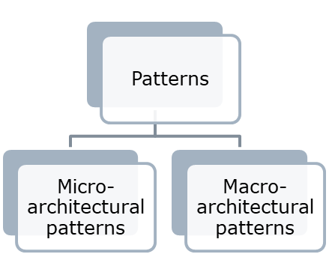
Architectural patterns
Pattern is a stylized description of good design practice, which has been tried and tested in different environments.
  Patterns should include information about when they are and when they are not useful.
  There are several patterns under various categories. Generally, there are macro-architectural patterns and micro-architectural patterns.
A macro architectural pattern is a way to implement an Architectural Style at the highest level of abstraction.
Micro architectural pattern (design pattern) is a way to solve a localised problem.

Slide 3
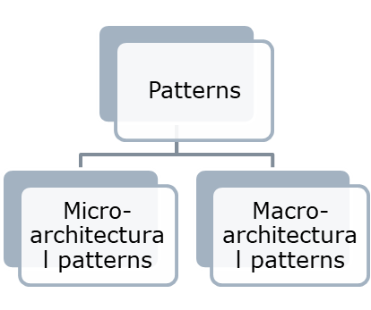
Architectural patterns
Architectural design patterns are useful for abstracting large systems of objects.
The different macro architectural patterns are:
  Pipes and Filters
  Client-server
  Repository
  Layered
  Model-View-Controller

Slide 4
Pipes and Filters
Def:
This pattern has independent entities called filters (components) which perform transformations on data and process the input they receive, and pipes, which serve as connectors for the stream of data being transformed, each connected to the next component in the pipeline.
An output of one component is input to the next component.
For example, the system that needs to process a large amount of data coming from multiple sources and apply transformations to it before storing it in a database
CIS Department, UTP Malaysia

Slide 5

Description
In this architecture, the stream of data is going through successive transformations to reach the target i.e., the database.
The figure depicts the processing pipes and filter pattern. The data arrives at the filters from other filters and eventually ends at the data target.
CIS Department, UTP Malaysia

Slide 6
Description Cont. …
The filter can take and provide data to one or more ports. the filters are independent and can run parallelly. The order of the filters is very important as the out-of-one filter is input to the other filter.
Example: Pipe and Filters pattern to design database:
Input Filter: This filter receives data from various sources (e.g., databases) and normalizes it into a standardized format.
Validation Filter: This filter validates the data to ensure that it meets certain criteria (e.g., data type, range, format).
Transformation Filter: This filter applies various transformations to the data (e.g., sorting, filtering, aggregating) based on business rules or user requirements.
Output Filter: This filter writes the processed data to a database or file in a standardized format.
CIS Department, UTP Malaysia

Slide 7
Pros and Cons
Pros:
  Ensures loose and flexible coupling of components (filters).
    Loose coupling allows filters to be changed without modifications to other filters.
  Conductive to parallel processing.
    Filters can be treated as black boxes. Users of the system don’t need to know the logic behind the working of each filter.
  Re-usability. Each filter can be called and used repeatedly.
Cons:
  The addition of many independent filters may reduce performance due to excessive computational overheads.
  Not a good choice for an interactive system.
CIS Department, UTP Malaysia

Slide 8
Application(s)
Compiler
A program that converts instructions into machine code so that they can be read and executed by a computer.
A compiler performs language transformation: Input is in language A and output is in language B. To do that the input goes through various stages inside the compiler. These stages form the pipeline. The most used division consists of 3 stages: front-end, middle-end, and back-end.
  The front end: responsible for parsing, performing syntax and semantics and then transforming it into an intermediate language.
  The middle-end takes the intermediate representation and usually performs several optimization steps on it, and the resulting transformed program in it passed to the back end.
  The back end transforms it into language B.
CIS Department, UTP Malaysia

Slide 9
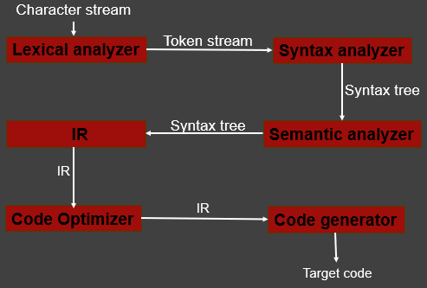
Compiler
CIS Department, UTP Malaysia

Slide 10
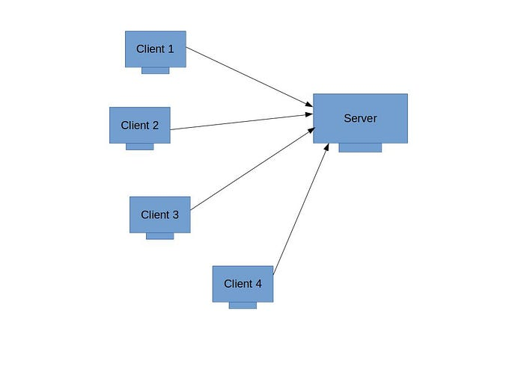
Client-Sever Pattern
Definition
Two main components: Client and Server
  The client is a requester, and the Server is a provider
  They often communicate over a network on separate hardware.
  A server may take multiple requests.
CIS Department, UTP Malaysia

Slide 11
Description
The interactions with the server are initiated by the client to generate the services needed.
The client component runs on the user's device and is responsible for presenting the user interface and making requests to the server.
The server component runs on a remote machine and is responsible for processing requests, retrieving data, and returning results to the client.
The client component includes a user interface that interacts with the user and displays information about the application.
The server component processes client requests, performs business logic, accesses data, and returns responses to the client. It may also be responsible for managing resources such as databases or other services.
CIS Department, UTP Malaysia

Slide 12
Description Cont. …
This pattern enables the application to be split into two distinct parts with their own responsibilities. This separation of concerns makes the application easier to manage, scale, and evolve.
For example,
The server component can be scaled independently of the client component, which can help to improve performance when many clients are accessing the application simultaneously.
Similarly, changes to the user interface or client logic can be made without affecting the server component, and vice versa, making it easier to maintain and evolve the application over time.
A classic example of this architectural pattern is the World Wide Web.
CIS Department, UTP Malaysia

Slide 13
Example
Suppose we have an online bookstore application that allows customers to browse books, place orders, and track their shipment status. We can use the Client-Server pattern to design this application as follows:
The client component of the application is the user interface that runs on the customer's device, such as a web browser or mobile app. It interacts with the server component to request and receive data.
The server component process client requests, retrieve and stores data, and provides responses to the client. It runs on a separate machine or cluster of machines and can handle multiple client requests concurrently.
CIS Department, UTP Malaysia

Slide 14
Example Cont. …
The database component of the application stores all the book and customer information, as well as the order and shipment details.
When a customer uses the bookstore application, they interact with the client component by browsing the catalogue, selecting items, and placing orders. The client then sends requests to the server component over the internet. The server processes the request retrieves data from the database if needed and sends a response back to the client.
The Client-Server pattern enables us to separate the concerns of the user interface (client) and the data storage and processing (server).
CIS Department, UTP Malaysia

Slide 15
Repository Pattern
Definition
A repository architecture consists of a central data structure (often a database) and a collection of independent components which operate on the central data structure
For Example, blackboard architectures, where a blackboard serves as the communication centre for a collection of knowledge sources, and database systems serving several applications
Repositories are very important for data integration and are being introduced in a variety of applications, including software development, CAD etc.
CIS Department, UTP Malaysia

Slide 16
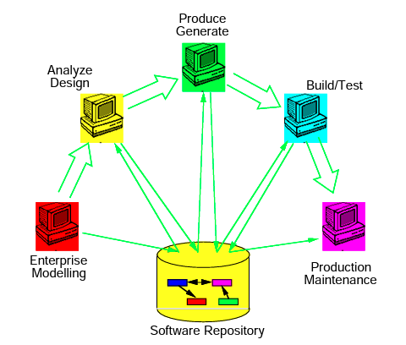
Block Diagram
CIS Department, UTP Malaysia

Slide 17
Description
It provides an abstraction layer between the application and the data store.
This layer isolates the application from the details of data storage and provides a single point of access for all data-related operations.
The Repository acts as an intermediary between the business logic and the data store and hides the complexity of the data storage mechanism.
The data access layer consists of the following components:
Repository interface: It defines the operations that the application can perform on the data store. This includes methods for adding, updating, and deleting data, as well as querying the data store for specific data items.
CIS Department, UTP Malaysia

Slide 18
Description Cont. …
Concrete repository: This component interacts with the data store (e.g., a database, a file system, a web service) to perform the required operations.
Domain model: It consists of the business objects and entities and is used to represent data within the application and to define the relationships between data items.
The Repository pattern offers several benefits, including:
Separation of concerns: Separates the data access and storage concerns from the application, making it easier to maintain and modify the application.
Standardized interface: It provides an interface for accessing data, making it easier to switch between different data storage technologies without modifying the application code.
Testability: This facilitates unit testing by providing an abstraction layer that can be easily mocked or stubbed for testing purposes.
CIS Department, UTP Malaysia

Slide 19
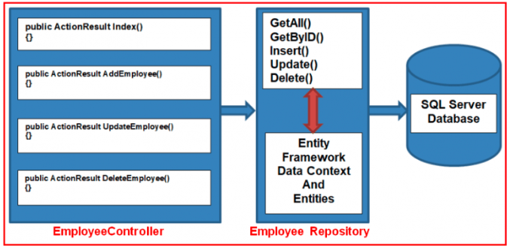
Example
Repository act as a middleman
CIS Department, UTP Malaysia

Slide 20
Layered Architecture Pattern
Name | Layered architecture
Description | Organizes the system into layers with related functionality associated with each layer. A layer provides services to the layer above it so the lowest-level layers represent core services that are likely to be used throughout the system.
Example | A layered model of a system for sharing copyright documents held in different libraries.
When used | Used when building new facilities on top of existing systems; when the development is spread across several teams with each team responsible for a layer of functionality; and when there is a requirement for multi-level security.
Advantages | Allows replacement of entire layers so long as the interface is maintained. Redundant facilities (e.g., authentication) can be provided in each layer to increase the dependability of the system.
Disadvantages | In practice, providing a clean separation between layers is often difficult and a high-level layer may have to interact directly with lower-level layers rather than through the layer immediately below it. Performance can be a problem because of multiple levels of interpretation of a service request as it is processed at each layer.

Slide 21
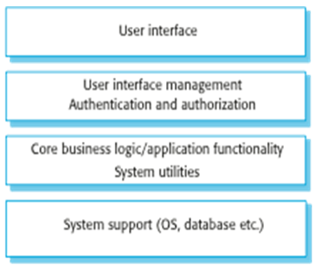
Layered Architecture Pattern
Components are grouped and separated into layers.
Components in the same layer are coupled. Components between different layers are loosely coupled through interfaces.
Example of generic layered architecture

Slide 22
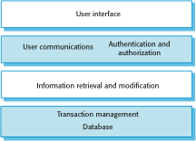
Layered Information systems Architecture
Information systems have a generic architecture that can be organised as a layered architecture.
Layers include:
  The user interface
  User communications
  Information retrieval
  System database

Slide 23
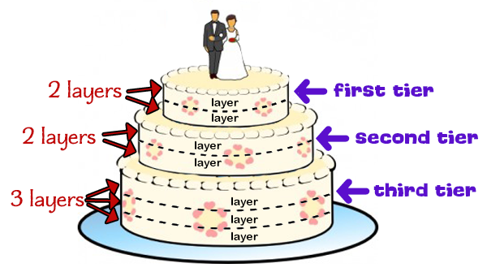

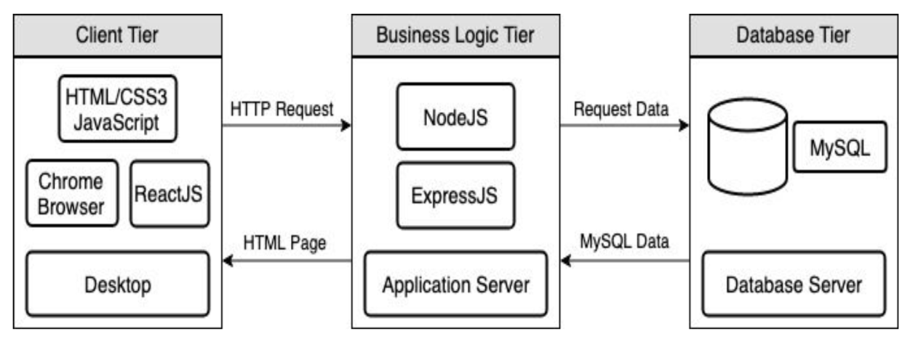




Tier and Layer
Client/Presentation tier
The tier in which users interact with an application.
Business/Middle tier
Mediates client tier and data tier using business algorithms.
Database/Data tier
Storage of application data.

Slide 24
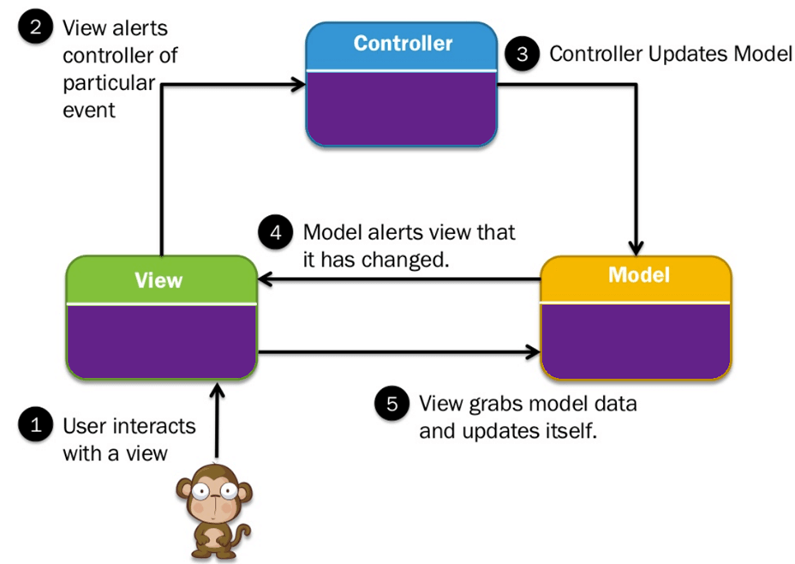
Model-View-Controller Pattern
This Model separates an application into three main logical components Model, View, and Controller.
CIS Department, UTP Malaysia

Slide 25
Components
View
It represents the presentation of data. It requests the model to give information so that it presents the output presentation to the user.
It also represents the data from charts, diagrams, and tables. For example, any customer view will include all the UI components like text boxes, drop downs, etc.
Controller
It handles user interaction. The controller interprets the mouse and keyboard inputs from the user, informing the model and the view to change as appropriate.
It sends commands to the model to update its state(E.g., Saving a specific document). It also sends commands to its associated view to change the view’s presentation (For example scrolling a particular document).
Model
It stores data and its related logic. It represents data that is being transferred between controller components or any other related business logic. i.e., a Controller object will retrieve the customer info from the database. It manipulates data and sends it back to the database.
It responds to the request from the views and responds to instructions from the controller to update itself. It is also the lowest level of the pattern which is responsible for maintaining data.
CIS Department, UTP Malaysia

Slide 26
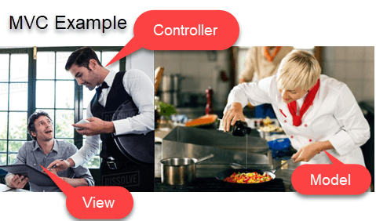
Example
View= You
Waiter= Controller
Cook= Model
Refrigerator= Data
CIS Department, UTP Malaysia

Slide 27
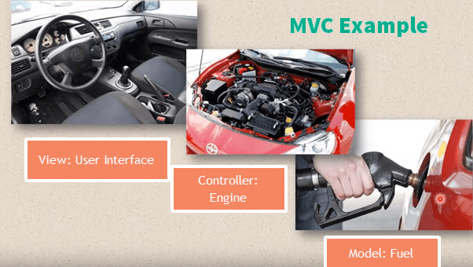
Example
View= User interface : (Gear lever, panels, steering wheel, brake, etc.)
Controller- Mechanism (Engine)
Model- Storage (Petrol or Diesel tank)
CIS Department, UTP Malaysia

